Slide 1
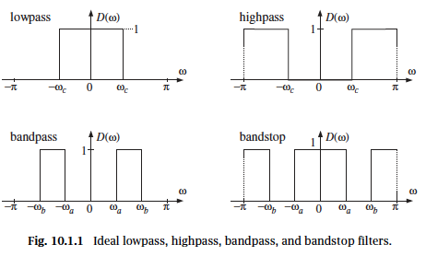

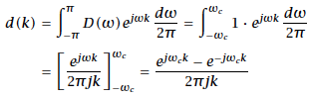

FIR Filter Design
1

Slide 2

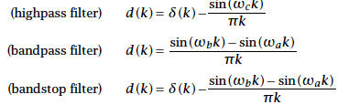

FIR Filter Design
2

Slide 3
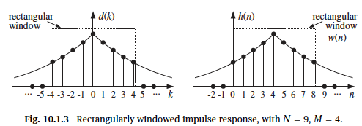

Rectangular Window Method
3

Slide 4




Rectangular Window Method
4

Slide 5
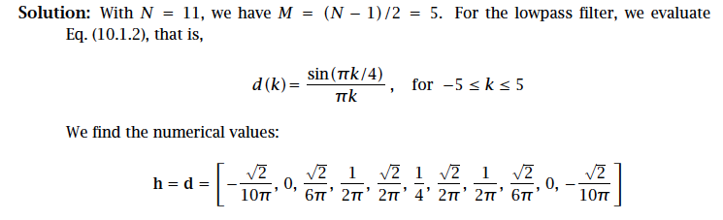

Slide 6
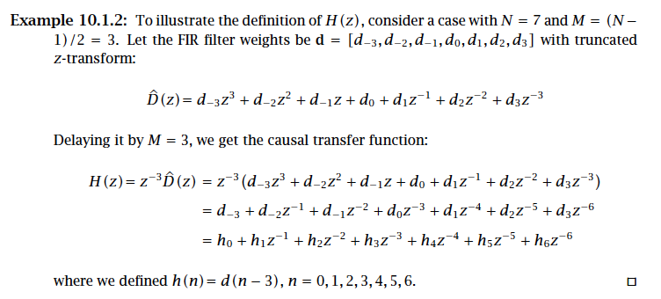

Slide 7
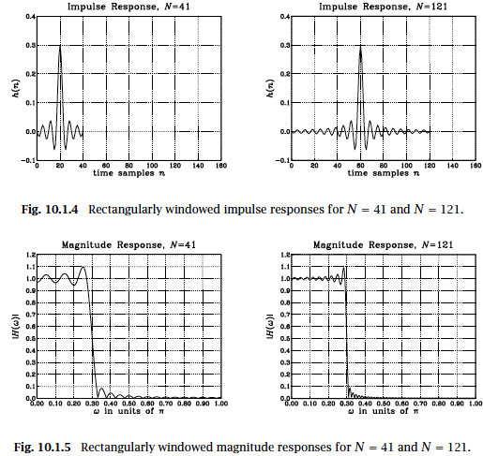
Rectangular Window Method
7

Slide 8
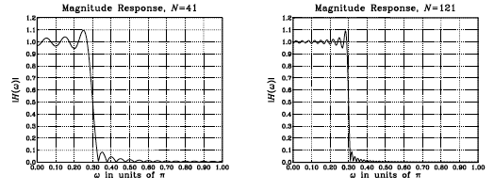

Rectangular Window Method
8

Slide 9

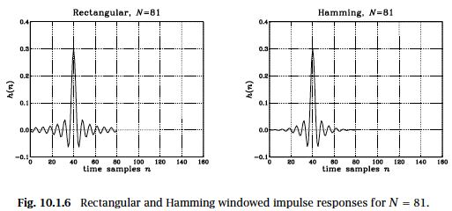
Hamming Window Method
9

Slide 10
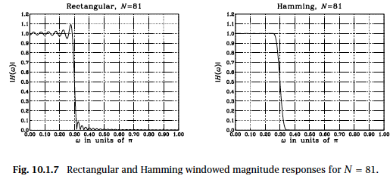

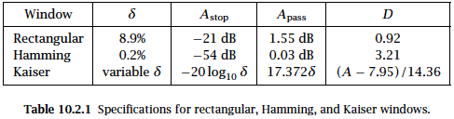
Hamming Window Method
10

Slide 11
FIR Filter DESIGN SPECIFICATION kaiser window

Slide 12
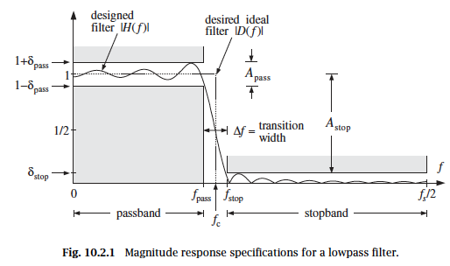




General Filter Specifications
Can go back and forth
between these sets of specs
12

Slide 13


General Filter Specifications
13

Slide 14


General Filter Specifications
14

Slide 15

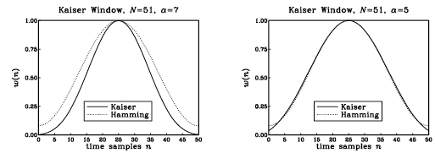
Kaiser Window
D relates to
transition width
Rectangular - best
15

Slide 16


Kaiser Window
16

Slide 17

FIR filter design
Filter Specifications
FIR Filter
Design procedure
FIR – h
17

Slide 18
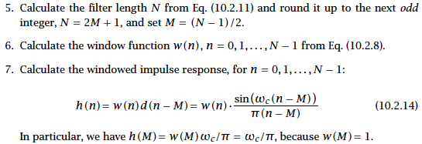
Kaiser filter design
18

Slide 19
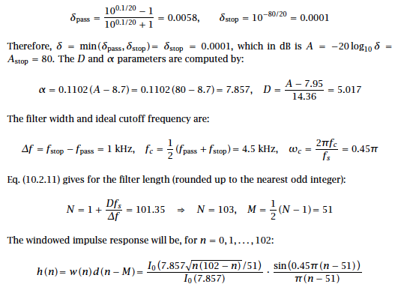
Kaiser filter design
19

Slide 20
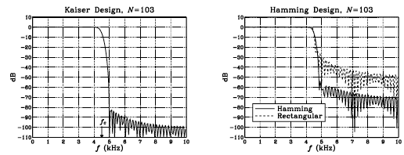

Kaiser filter design
20

Slide 21
Conclusion
Reference: Orfanidis – chapter 10 FIR Filter design
Filter Specs
Rectangular, Hamming – Cut off frequency
Kaiser -
Kaiser
Better Stop band attenuation
Homework
f_{pass} – 5KHz; f_{stop}- 6KHz; A_{stop} = 70dB

